Slide 1
Security Threats
Sang ah Park 70309

Slide 2
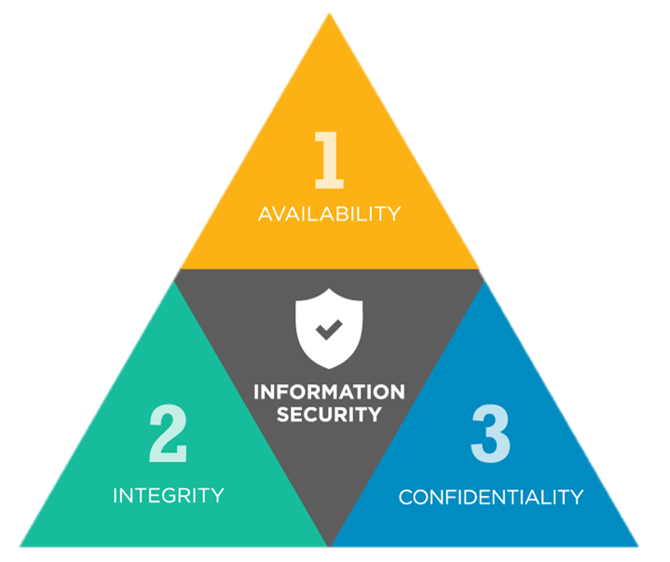
CIA triad
A common model that forms the basis for the development of security systems.
CIA stand for Confidentiality, Integrity, and Availability.
Following security threats can be categorized by these three sectors.

Slide 3
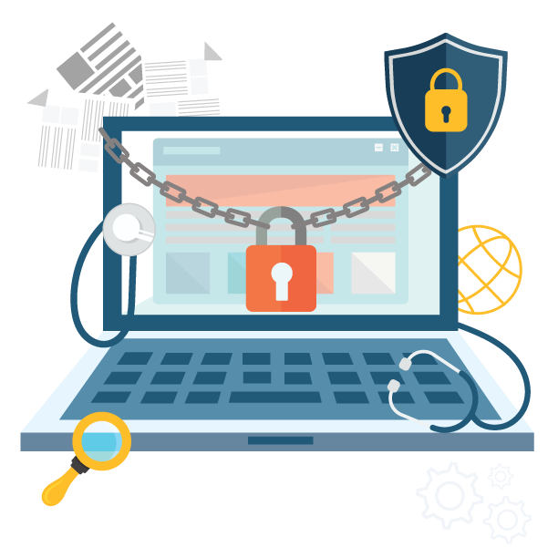
Confidentiality
Confidentiality is keeping information private.
When a user provides personal information, such as a credit card number, or medical information, they expect that unauthorised people won’t see the data.
Companies have an obligation to ensure confidentiality.

Slide 4
Threats on Confidentiality
- Snooping (=Sniffing)
Network administrators have a tool called a protocol analyzer, which let them capture network traffic and analyse its contents.
When this is used by unauthorised people, this type of attack is called snooping.
Attackers try to capture network traffic and then look for key pieces of information.

Slide 5
Threats on Confidentiality
- Phishing
Phishing is a form of social engineering
Attackers use email to ask users for a piece of information by making it look as if it is a legitimate request.
The email usually looks like it comes from an official source, and leads users to click a link and type in their personal information.

Slide 6
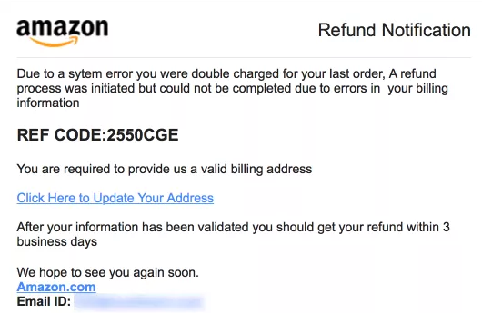
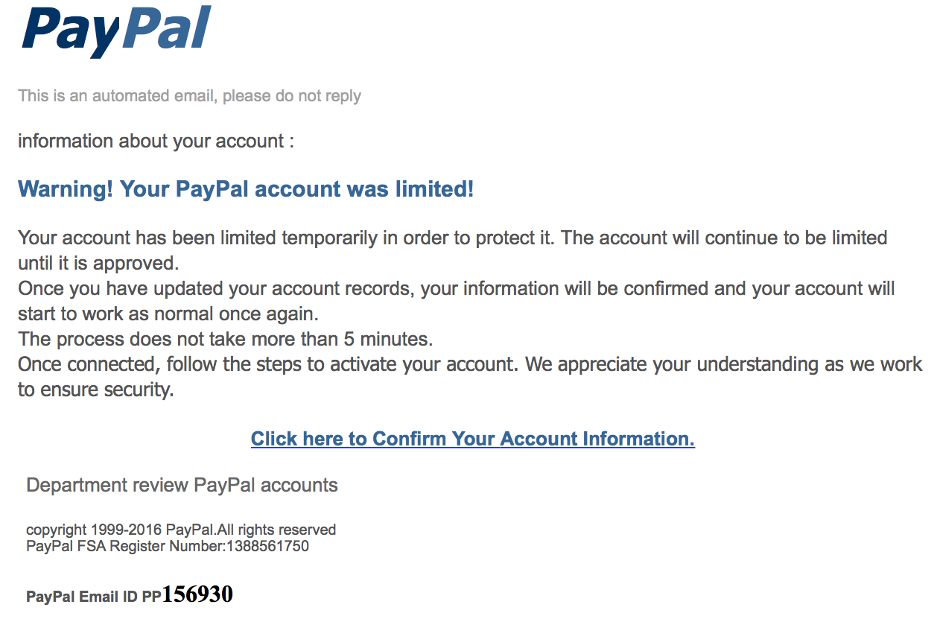
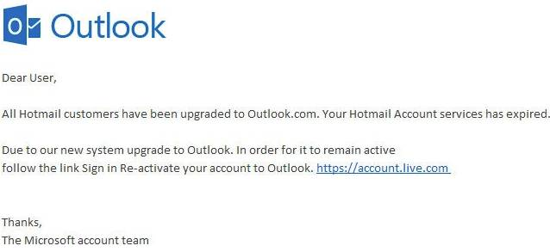
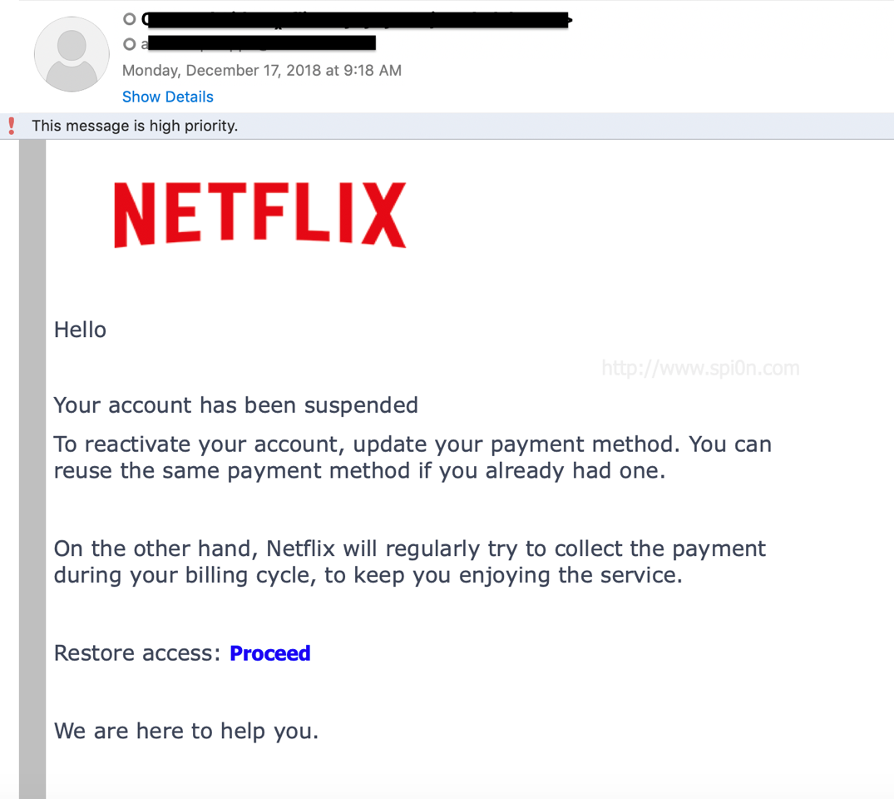
Examples of Phishing Email

Slide 7
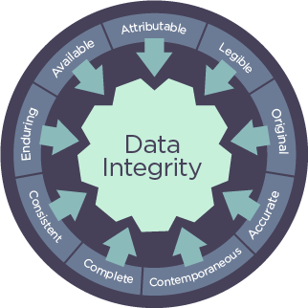
Integrity
Integrity means that the data is accurate and consistent and from the indicated source.
For example, someone logging into a credit card company's website expects that it's really that company and that the information they see regarding the charges to their account is valid.

Slide 8

Threats on Integrity
- Man-in-the-middle attack
In a man-in-the-middle attack, attackers place a piece of software or an unauthorised router between a server and the client and intercept data and alter it.
A common solution to this problem is to enforce a secure wireless authentication protocol such as WPA2.

Slide 9
Threats on Integrity
- Impersonation
Impersonation means pretending to be someone or something that you are not.
The same thing can happen on computer networks as well. The server will respond to what it thinks is a legitimate IP address, and the attacker is on the way to achieving their goal.

Slide 10
Threats on Integrity
- Unauthorised information Alteration
Once into a system, attackers can change information in an attempt to damage a business or person and many times.
This involves altering data within a database.
This can also come from internal sources.

Slide 11
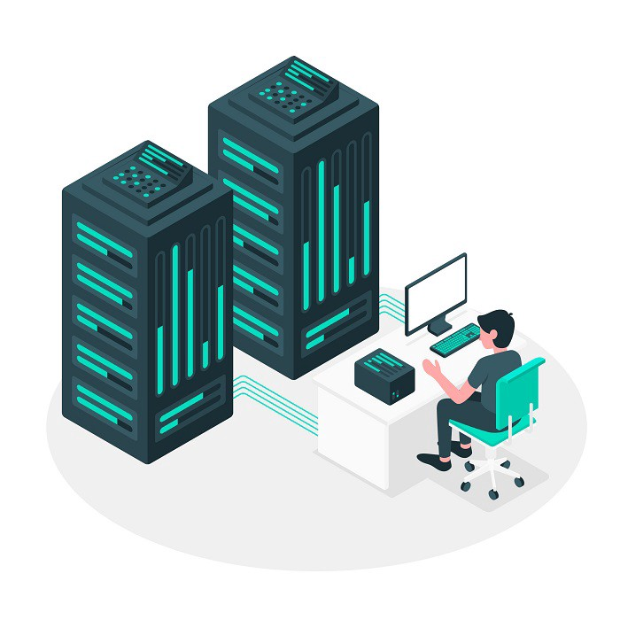

Availability
Availability means that the data is accessible when the user needs it.

Slide 12
Threats on Availability
- Denial of Service(DoS)
Attackers flood a server with a multitude of illegitimate connection requests so that it’s unable to respond to legitimate requests.
When the attackers command multiple infected systems across the internet, it is called a distributed denial of service(DDoS).

Slide 13
Software-Based Security Threats
- Exploits
Every OS and application has potential vulnerabilities
When criminals use this for malicious purposes, it is called an exploit.
- Viruses
A virus is computer code that inserts itself into an executable file.
When that file is run, the virus code executes along with the application code and self-replicates and spread from one file to another.
These are used to cause damage and disruption to the system.

Slide 14
Software-Based Security Threats
- Worms
A worm is different from a virus in that it can reproduce itself, it's self-contained, and it doesn’t need a host to be transmitted. Worms are used to transmit malware.
- Trojan Horses
There are applications that mask their true intent.
They pretend to offer services, such as system scanning to detect malware but instead cause a problem and ask users to pay to fix it.

Slide 15
Software-Based Security Threats
- Adware
These are used to display unwanted advertisements.
- Spyware
These are used to record your computer usage and possibly steal data.
- Ransomware
There are used to extract payments from the infected user.

Slide 16
Software-Based Security Threats
- Rootkits
There conceal themselves on the host OS, allowing for full-control access of the computer at a later date.
- Backdoors
These open ports or other routes into your system.
- Keyloggers
These record every keystroke and then send information to a remote location. The attackers use that data for identity theft.

Slide 17
Thank you

